Slide 1
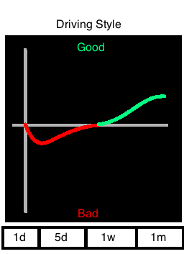
Driving Data - Encourage Use
In addition to the points that the user accumulates, show the user a graph of their driving data over time.

Slide 2
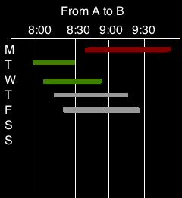
Driving Data - Encourage Use
Analyze a common route to determine average travel time.
Include time of day to help the user understand traffic flow on common route.

Slide 3
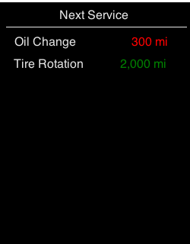
Driving Data - Encourage Use
Maintenance log to show recommend services.
Points awarded for completing maintenance.
Don’t have access to odometer readings, so this could be off if the user travels in another vehicle.

Slide 4
Driving Data - Improvements
Capture phone orientation. Once a trip begins, the phone orientation shouldn’t change much unless the driver is interacting with the device.
Periodic challenges to complete common safety checks.
Check turn signals and tail lights
Check tire pressure / tread life
Check wiper blades

